Slide 1


Explainable query generation for cohort discovery and biomedical reasoning using natural language
Nic Dobbins
UW Biomedical Natural Language Processing Group
UW Medicine Research IT Department of Biomedical Informatics & Medical Education
University of Washington, Seattle, WA
November 14th, 2022

Slide 2
Outline
Introduction
Related Works
Task Innovation
Specific Aims
Conclusion

Slide 3

Introduction
Related Work
Task Innovation
Specific Aims
Conclusion
Cohort Discovery
5.5m patients (EHR)
Process of finding patients meeting certain criteria relevant to a potential study
Often used in prep-to-research, hypothesis generation, power calculations, clinical trial recruitment, etc.
Can be done by manual chart review, electronic case report forms (eCRF), or queries of clinical databases
Over 65
Hypoglycemic
Left-handed
1,422 patients

Slide 4
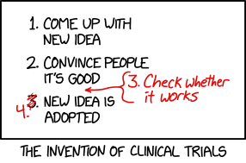
Introduction
Related Work
Task Innovation
Specific Aims
Conclusion
Randomized Controlled Trials
Prospective study designed to determine whether an intervention (drug, device, etc.) is safe and effective
“Randomized” if participants randomly assigned to different groups
“Controlled” if includes a control group which does not receive intervention in question
“Blinded” if participants do not know which group they are in (and “double-” if investigators do not either)
I will refer to interchangeably with “clinical trials”, though not technically synonymous
https://xkcd.com/2530

Slide 5
Introduction
Related Work
Task Innovation
Specific Aims
Conclusion
Clinical Trials
Conducted in “phases” which build upon one another.
Phase 0: Explore if new treatment will work. very small, not widely used; very small doses given.
Phase I: Is treatment safe? Find highest dose that can be given safely, look for side effects.
Phase II: Does treatment work? Participants typically receive same dose, no placebos used.
Phase III: Treatment better than alternatives? Larger number of patients, longer duration, often randomized & blinded, typically include controls.
Phase IV: What else need to know? Even longer duration (e.g., years), more participants, study long-term effects, cost effectiveness, etc.
Sources:
-Mahan, Vicki L. "Clinical trial phases." International Journal of Clinical Medicine 5.21 (2014): 1374.
-https://www.cancer.org/treatment/treatments-and-side-effects/clinical-trials/what-you-need-to-know/phases-of-clinical-trials.html

Slide 6
Introduction
Related Work
Task Innovation
Specific Aims
Conclusion
Clinical Trials - challenges
Expensive – between 2004 & 2016, mean costs:
Phase I: $3.8m
Phase II: $13.3m
Phase III: $19.8m.
Finding and maintaining eligible, representative patients time-consuming and costly.
Eligibility criteria – inclusion and exclusion requirements of eligible patients – often complex; some argue overly restrictive.
Patients recruited tend to be whiter and more affluent than populations at large.
Sources:
-Sertkaya, Aylin, et al. "Key cost drivers of pharmaceutical clinical trials in the United States." Clinical Trials 13.2 (2016): 117-126.
-G. Frank. Current challenges in clinical trial patient recruitment and enrollment. SoCRA Source, 2(February):30–38, 2004.
-C. Heller, J. E. Balls-Berry, J. D. Nery, P. J. Erwin, D. Littleton, M. Kim, and W. P. Kuo. Strategies addressing barriers to clinical trial enrollment of underrepresented populations: a systematic review. Contemporary clinical trials, 39(2):169–182, 2014.

Slide 7
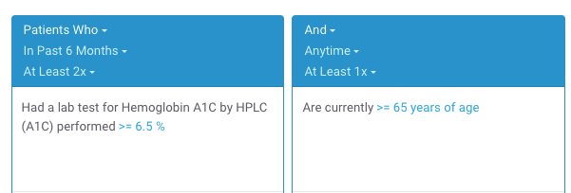
Introduction
Related Work
Task Innovation
Specific Aims
Conclusion
Clinical Trials Recruitment and (Cohort Discovery) Software
Computer software cannot solve all challenges related to clinical trials.
However, can (sometimes) reduce manual workloads and save time/costs related to recruitment.
Existing cohort discovery tools can be used by manually translating free-text eligibility criteria into database queries.
“- At least 2 A1c tests > 6.5%
- 65+ y/o”
2,273 patients found
Example Leaf query.
Sources:
-Johnson, Emilie K., et al. "Use of the i2b2 research query tool to conduct a matched case–control clinical research study: advantages, disadvantages and methodological considerations." BMC medical research methodology 14.1 (2014): -L. Penberthy, R. Brown, F. Puma, and B. Dahman. Automated matching software for clinical trials eligibility: measuring efficiency and flexibility. Contemporary clinical trials, 31(3):207–217, 2010.
-S. R. Thadani, C. Weng, J. T. Bigger, J. F. Ennever, and D. Wajngurt. Electronic screening improves efficiency in clinical trial recruitment. Journal of the American Medical Informatics Association, 16(6):869–873, 2009.

Slide 8
Introduction
Related Work
Task Innovation
Specific Aims
Conclusion
Clinical Trials Recruitment and (Cohort Discovery) Software
Existing drag-and-drop cohort discovery tools are not a panacea:
Significant learning curves.
Visual representation of data discordant with “mental maps” of how data are collected or stored.
May be structurally unable to represent certain complex criteria or sequences of events.

Slide 9

Introduction
Related Work
Task Innovation
Specific Aims
Conclusion
Clinical Trials Recruitment and Natural Language Processing (NLP)
Alternatively, using NLP to automatically analyze free-text eligibility criteria and find patients has appeal.
Researchers are accustomed to writing criteria using natural language.
No (or less) need to learn special tools.
“- At least 2 A1c tests > 6.5%
- 65+ y/o”
2,273 patients found

Slide 10
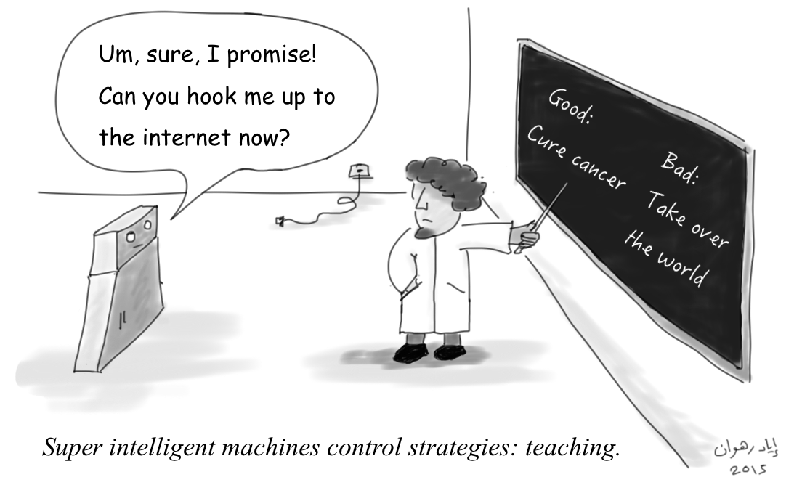
Introduction
Related Work
Task Innovation
Specific Aims
Conclusion
Project Goals
Create a human-annotated gold standard corpus of eligibility criteria.
Develop state-of-the-art NLP-based methods for generating SQL queries for cohort discovery from free-text.
Develop a web application for finding patients meeting user-provided free-text eligibility criteria.

Slide 11
Introduction
Related Work
Task Innovation
Specific Aims
Conclusion
Challenges
What kind of surgery?
When is “newly”?
1. Newly diagnosed with breast cancer and scheduled for surgery
2. 18 years or above
3. Those who experience high psychological stress will enter the RCT whereas those with low stress will be followed in an observational questionnaire study
4. No severe psychiatric disease requiring treatment, e.g., schizophrenia
What is 18 years or above?
Statement of fact, not a criterion
What could these be?
Many of these relate to reasoning. Also: acronyms, misspellings, etc.
Adapted from trial NCT03254875 at https://clinicaltrials.gov/ct2/show/NCT03254875

Slide 12
Introduction
Related Work
Task Innovation
Specific Aims
Conclusion
Broader Impact
Methods for finding cohorts may also be expanded to general purpose question-answering.
Cohort discovery using NLP may be useful for other kinds of biomedical research unrelated to clinical trials.
Evaluating system performance by comparing patients found to those actually enrolled in trials (Aim 2, discussed shortly) is a novel, high standard for this task

Slide 13
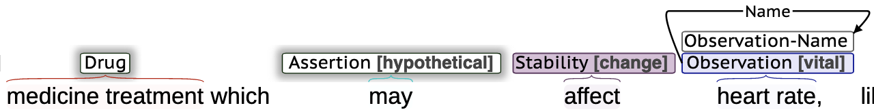
Introduction
Related Work
Task Innovation
Specific Aims
Conclusion
Definitions
Named Entity Recognition – information extraction task for identifying and classifying spans of text into pre-determined categories.

Slide 14
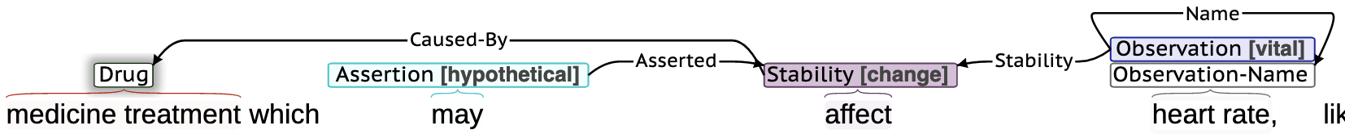
Introduction
Related Work
Task Innovation
Specific Aims
Conclusion
Definitions
Relation Extraction – information extraction task for identifying semantically meaningful connections between entities, such as when one entity acts upon, is found by, caused by, or related in some way to another.

Slide 15
Introduction
Related Work
Task Innovation
Specific Aims
Conclusion
Definitions
Sequence-to-Sequence (Seq2Seq) – machine learning methods for transforming a sequence of characters into a different sequence of characters.
Semantic Parsing – process of translating a natural language utterance into a computable meaning representation.
intersect(
female(),
age()
.num_filter(
eq(op(BETWEEN), val(”18”), val(“41”))
)
)
Semantic Parser
“Women aged 18-41”

Slide 16
Introduction
Related Work
Task Innovation
Specific Aims
Conclusion
Definitions
Unified Medical Language System (UMLS) – “metathesaurus” of biomedical concepts, terms, codes, relations and hierarchies bridging various vocabularies and ontologies.
ICD-10 J45.9
Lung C0024109
Asthma C0004096
has_associated_location
has_associated_anatomic_site
Respiration C0035203
SNOMED 195967001
HPO HP:0002099

Slide 17
Introduction
Related Work
Task Innovation
Specific Aims
Conclusion
Definitions
Normalization – process of mapping text to coded values of some vocabulary, ontology, or other organization of concepts.
Metformin C0025598
”Metformin”

Slide 18
Introduction
Related Work
Task Innovation
Specific Aims
Conclusion
Related Work
Corpora of eligibility criteria
Methods for cohort discovery from free-text criteria
NLP-based software for cohort discovery

Slide 19
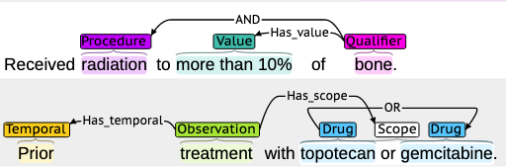
Introduction
Related Work
Task Innovation
Specific Aims
Conclusion
Corpora of Eligibility Criteria
EliXR by Weng et al. – 1,000 annotated eligibility criteria documents from various disease domains, custom schema. Not publicly available.
EliIE by Kang et al. – 230 annotated eligibility criteria related to Alzheimer's Disease, based on the OMOP database schema.
Chia by Kury et al. – 1,000 annotated eligibility criteria from various disease domains, based on OMOP database schema.
Example Chia annotation.
Sources:
-C. Weng, X. Wu, Z. Luo, M. R. Boland, D. Theodoratos, and S. B. Johnson. EliXR: an approach to eligibility criteria extraction and representation. Journal of the American Medical Informatics Association, 18. Dec 2011. -T. Kang, S. Zhang, Y. Tang, G. W. Hruby, A. Rusanov, N. Elhadad, and C. Weng. EliIE: An open-source information extraction system for clinical trial eligibility criteria. JAMIA, 24(6):1062–1071, 2017. -F. Kury, A. Butler, C. Yuan, L.-h. Fu, Y. Sun, H. Liu, I. Sim, S. Carini, and C. Weng. Chia, a large annotated corpus of clinical trial eligibility criteria. Scientific data, 7(1):1–11, 2020.

Slide 20
Introduction
Related Work
Task Innovation
Specific Aims
Conclusion
Methods for generating SQL queries from free-text criteria
Database query generation
Document ranking and classification
Embeddings and similarity measurement
Logical representations and ontologies
A combination of the above

Slide 21
Introduction
Related Work
Task Innovation
Specific Aims
Conclusion
Database Query Generation
Extensive recent Seq2Seq work using text-to-SQL generation with Encoder-Decoder Transformer architectures.
Used in the biomedical domain for question-answering on electronic health record data, most notably by Bae et al., Wang et al. and Pan et al.
Yu et al. used templated eligibility criteria to generate SQL queries for hypothetical database schema.
SELECT patient_id
FROM labs
WHERE lab_type = ‘a1c’ AND value > 6.5
“Hemoglobin A1c > 6.5%”
Sources:
-S. Bae, D. Kim, J. Kim, and E. Choi. Question Answering for Complex Electronic Health Records Database using Unified Encoder-Decoder Architecture. In Machine Learning for Health, pages 13–25. PMLR, 2021.
-P. Wang, T. Shi, and C. K. Reddy. Text-to-SQL generation for question answering on electronic medical records. In Proceedings of The Web Conference 2020, pages 350–361, 2020. -Y. Pan, C. Wang, B. Hu, Y. Xiang, X. Wang, Q. Chen, J. Chen, J. Du, et al. A BERT-Based Generation Model to Transform Medical Texts to SQL Queries for Electronic Medical Records: Model Development and Validation. JMIR Medical Informatics, 9(12):e32698, 2021.
-Yu, Xiaojing, et al. "Dataset and enhanced model for eligibility criteria-to-SQL semantic parsing." 12th International Conference on Language Resources and Evaluation (LREC). 2020.

Slide 22
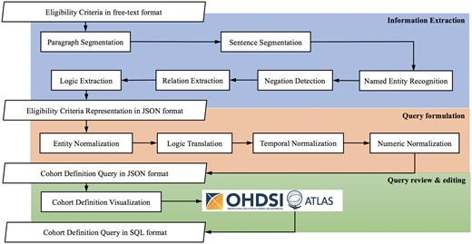
Introduction
Related Work
Task Innovation
Specific Aims
Conclusion
Database Query Generation (cont.)
Hybrid deep learning / rule-based -Criteria2Query (Yuan et al.) used BERT for negation detection and a Condition Random Field- (CRF) based classifier for Named Entity Recognition (NER).
Output values analyzed by rules to generate queries on OMOP.
Sources:
-C. Yuan, P. B. Ryan, C. Ta, Y. Guo, Z. Li, J. Hardin, R. Makadia, P. Jin, N. Shang, T. Kang, and C. Weng. Criteria2Query: A natural language interface to clinical databases for cohort definition. Journal of the American Medical Informatics Association, 26(4):294–305, 2019.
-Fang, Yilu, et al. "Combining human and machine intelligence for clinical trial eligibility querying." Journal of the American Medical Informatics Association (2022).

Slide 23



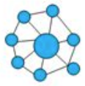
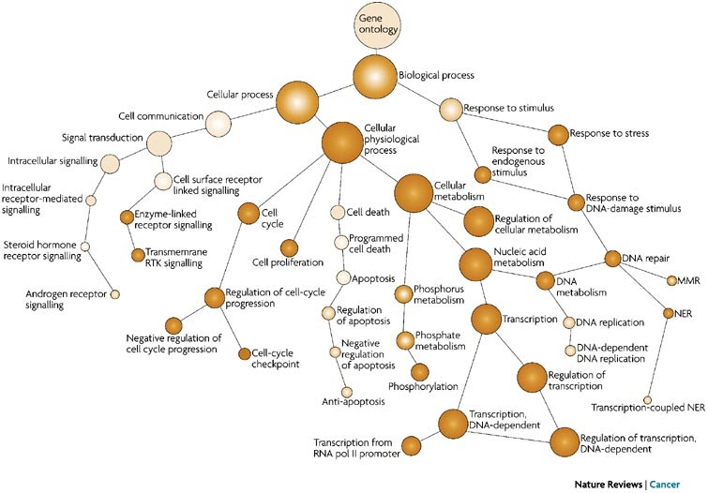
Introduction
Related Work
Task Innovation
Specific Aims
Conclusion
Other notable approaches
Document Ranking and Classification –Clinical notes sorted by most relevant using relatively small corpora of notes (low thousands) with different architectures (Chen et al.: biLSTM+CRF, Soni and Roberts: BERT).
Embeddings and similarity measurement – eligibility criteria and patient medical history represented as vectorized embeddings. Dhayne et al. used cosine similarity and heuristics to determine if patient met criteria; Zhang et al. treated as an entailment problem (ie, patient history entails criteria = { true, false, unknowable })
Logical representations and ontologies – Patrao et al. used pattern matching rules, RDF (Resource Description Framework) graphs and an OWL reasoner to predict eligibility. Others have proposed logical annotation representations for eligibility criteria.
Sources:
-L. Chen, Y. Gu, X. Ji, C. Lou, Z. Sun, H. Li, Y. Gao, and Y. Huang. Clinical trial cohort selection based on multi-level rule-based natural language processing system. JAMIA, 26(11):1218–1226, 2019.
-S. Soni and K. Roberts. Patient cohort retrieval using transformer language models. In AMIA annual symposium proceedings, volume 2020, page 1150. American Medical Informatics Association, 2020.
-H. Dhayne, R. Kilany, R. Haque, and Y. Taher. EMR2vec: Bridging the gap between patient data and clinical trial. Computers & Industrial Engineering, 156:107236, 2021.
-X. Zhang, C. Xiao, L. M. Glass, and J. Sun. DeepEnroll: patient-trial matching with deep embedding and entailment prediction. In Proceedings of The Web Conference 2020, pages 1029–1037, 2020.
-D. F. Patrão, M. Oleynik, F. Massicano, and A. Morassi Sasso. Recruit-An Ontology Based Information Retrieval System for Clinical Trials Recruitment. In MEDINFO 2015: eHealth-enabled Health, pages 534–538. IOS Press, 2015.

Slide 24
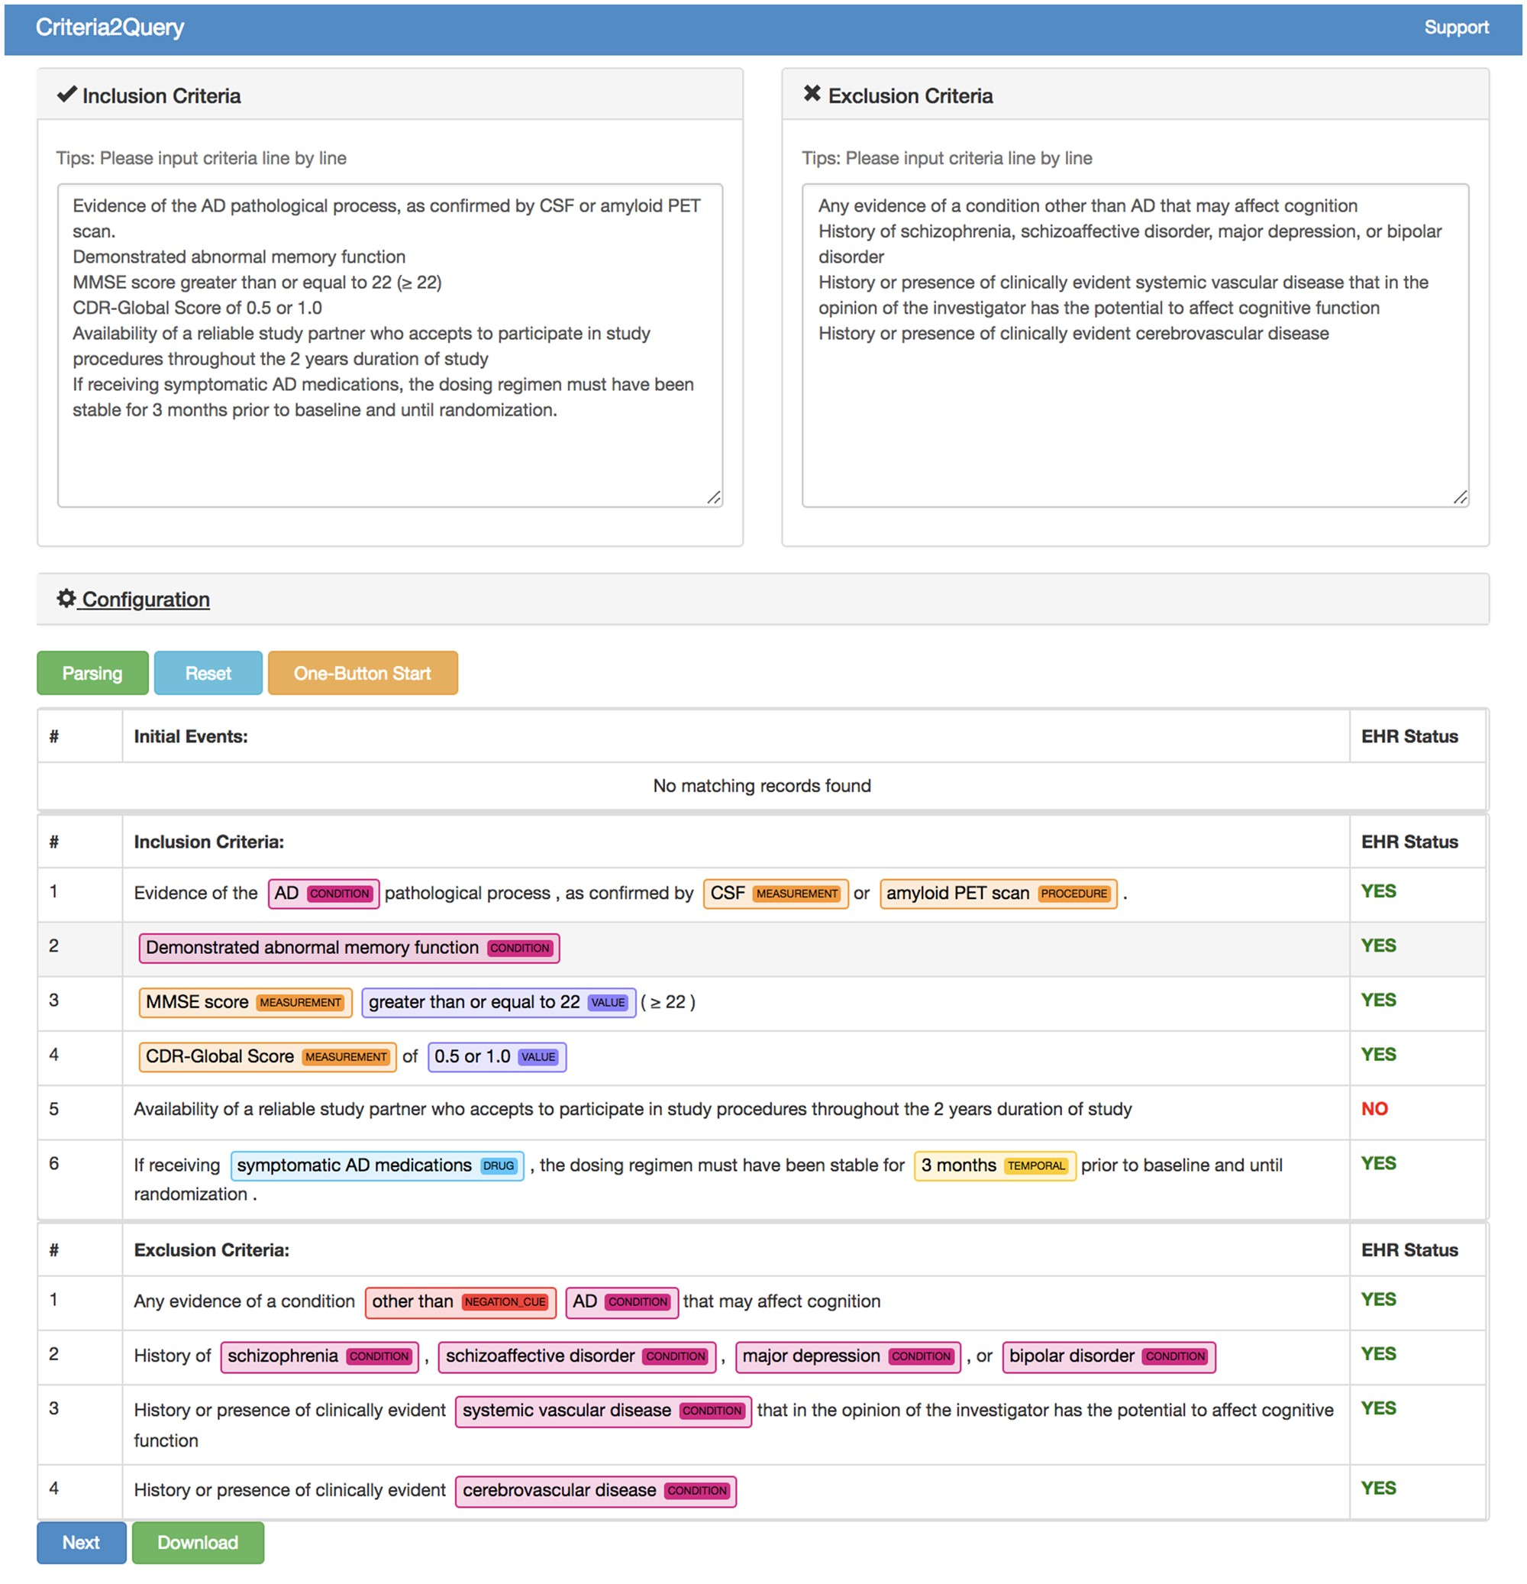
Introduction
Related Work
Task Innovation
Specific Aims
Conclusion
NLP-based software for cohort discovery
Criteria2Query by Yuan et al. most well known and recent.
Expanded by Fang et al. to allow users to edit predicted criteria, normalizations.
Outputs JSON-based logical representation of criteria to ”Atlas” tool, which in turn generates SQL from rules.
Returns a table of patients meeting criteria.
Sources:
-Yuan, Chi, et al. "Criteria2Query: a natural language interface to clinical databases for cohort definition." Journal of the American Medical Informatics Association 26.4 (2019): 294-305.
-Fang, Yilu, et al. "Combining human and machine intelligence for clinical trial eligibility querying." Journal of the American Medical Informatics Association (2022).

Slide 25
Introduction
Related Work
Task Innovation
Specific Aims
Conclusion
Task Innovation
Corpora of eligibility criteria Our corpus is broad, large, and rich in granularity for generating accurate queries.
Methods for cohort discovery from free-text criteria Our methods will generalize to virtually any clinical database schema, be capable of reasoning upon non-specific criteria and demonstrate at or near state-of-the art results in matching cohorts of patients from actual clinical trials.
NLP-based software for cohort discovery Our system will be user-friendly, intuitive, explainable, and database schema-agnostic.

Slide 26
Introduction
Related Work
Task Innovation
Specific Aims
Conclusion
Specific Aims
Create gold standard corpus of eligibility criteria.
Develop methods for generating SQL queries for cohort discovery from free-text.
Develop a web application for finding patients meeting user-provided free-text eligibility criteria.

Slide 27
Introduction
Related Work
Task Innovation
Specific Aims
Conclusion
Aim
1
2
3
Specific Aims
Create gold standard corpus of eligibility criteria.
Develop methods for generating SQL queries for cohort discovery from free-text.
Develop a web application for finding patients meeting user-provided free-text eligibility criteria.

Slide 28
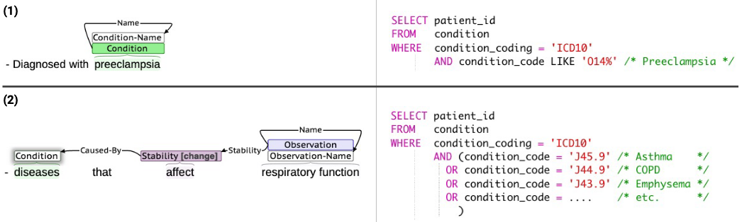
Introduction
Related Work
Task Innovation
Specific Aims
Conclusion
Aim
1
2
3
Aim 1 – Motivation
Create an annotated corpus which can be used to train prediction models to aid in SQL query generation.
Sources:
-Dobbins, Nicholas J., et al. "The Leaf Clinical Trials Corpus: a new resource for query generation from clinical trial eligibility criteria." Nature Scientific Data 9.1 (2022): 1-15.

Slide 29
Introduction
Related Work
Task Innovation
Specific Aims
Conclusion
Aim
1
2
3
Aim 1 – Corpus Creation
Downloaded 1,020 randomly selected eligibility criteria documents from https://clinicaltrials.gov
Limited to studies
From Jan. 1 2018 onward
50 or more characters in length
20 documents for annotator training, remainder for main annotation task
Named “Leaf Clinical Trials” or “LCT” corpus
Sources:
-Dobbins, Nicholas J., et al. "The Leaf Clinical Trials Corpus: a new resource for query generation from clinical trial eligibility criteria." Nature Scientific Data 9.1 (2022): 1-15.

Slide 30
Introduction
Related Work
Task Innovation
Specific Aims
Conclusion
Aim
1
2
3
Aim 1 – Annotation Schema
Aimed to develop expressive, task-oriented annotation schema.
Analyzed previously published corpora.
Expanded the list of named entities and relations to capture phenomena and logic present in real clinical trials criteria. For example, added “Contraindication” entity.
50 total entity types
Categories: Clinical, Demographic, Logical, Qualifier, Temporal & Comparative, Other
51 total relation types
Categories: Alternative & Example, Clinical, Dependent, Logical, Qualifier, Temporal & Comparative, Other

Slide 31
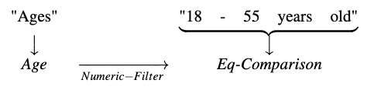
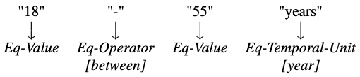
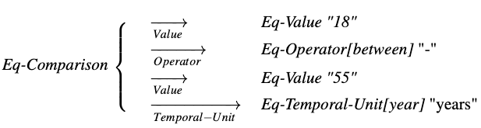
Introduction
Related Work
Task Innovation
Specific Aims
Conclusion
Aim
1
2
3
Aim 1 – Entities
(1) General entities and relations
2 types
”General” entities
“Fine-grained” entities
Fine-grained entities are sub-spans, link to general entities by relations.
(2) Fine-grained entities
(3) Relations between general and fine-grained

Slide 32
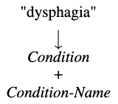
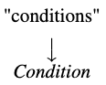
Introduction
Related Work
Task Innovation
Specific Aims
Conclusion
Aim
1
2
3
Aim 1 – Named versus Non-specific Entities
Named entities refer to specific conditions, observations, treatments, etc.
Non-specific entities refer generally to any condition, etc., which may need to be reasoned upon
Named
Non-specific

Slide 33
Introduction
Related Work
Task Innovation
Specific Aims
Conclusion
Aim
1
2
3
Aim 1 – Annotation Schema – Entity Examples
Category | Entity | Values | Example Text
Clinical | Condition |  | “Diagnosed with hypertension in past year”
 | Contraindication |  | “Any contraindications to vaginal delivery”
Clinical | Drug |  | “on beta blockers”
 | Encounter | emergency, inpatient, outpatient | “recently admitted to hospital”
 | Observation | lab, vital, clinical-score, survey, social-habit | “Platelet count less than 500”
 | Procedure |  | “Undergoing or scheduled for a colonoscopy”
Demographic | Age |  | “65+ years old”
 | Birth |  | “Born within past 6 months”
Demographic | Family-Member | mother, father, sibling, etc. | “History of maternal breast cancer”
 | Language |  | “Speaks English or Spanish”
Logical | Negation |  | “with no systemic disease”
Qualifier | Assertion | intention, hypothetical, possible | “which may cause conditions”
Qualifier | Modifier |  | “alcohol or substance abuse”
 | Polarity | low, high, positive, negative | “showing elevated serum creatinine”
 | Stability | stable, change | “Conditions known to affect mood”
Temporal & Comparative | Eq-Comparison |  | “greater than 50 ml”, “within the past 3 years”
Temporal & | Eq-Temporal-Period | past, present, future, recent | “Active illness”, “in the next 10 days”,
Comparative | Eq-Temporal-Recency | first-time, most-recent | “Latest BMI > 35”, “First diagnosed in past 6 months”

Slide 34
Introduction
Related Work
Task Innovation
Specific Aims
Conclusion
Aim
1
2
3
Aim 1 – Annotation Schema – Entity Examples
Category | Entity | Values | Example Text
Clinical | Condition |  | “Diagnosed with hypertension in past year”
 | Contraindication |  | “Any contraindications to vaginal delivery”
Clinical | Drug |  | “on beta blockers”
 | Encounter | emergency, inpatient, outpatient | “recently admitted to hospital”
 | Observation | lab, vital, clinical-score, survey, social-habit | “Platelet count less than 500”
 | Procedure |  | “Undergoing or scheduled for a colonoscopy”
Demographic | Age |  | “65+ years old”
 | Birth |  | “Born within past 6 months”
Demographic | Family-Member | mother, father, sibling, etc. | “History of maternal breast cancer”
 | Language |  | “Speaks English or Spanish”
Logical | Negation |  | “with no systemic disease”
Qualifier | Assertion | intention, hypothetical, possible | “which may cause conditions”
Qualifier | Modifier |  | “alcohol or substance abuse”
 | Polarity | low, high, positive, negative | “showing elevated serum creatinine”
 | Stability | stable, change | “Conditions known to affect mood”
Temporal & Comparative | Eq-Comparison |  | “greater than 50 ml”, “within the past 3 years”
Temporal & | Eq-Temporal-Period | past, present, future, recent | “Active illness”, “in the next 10 days”,
Comparative | Eq-Temporal-Recency | first-time, most-recent | “Latest BMI > 35”, “First diagnosed in past 6 months”

Slide 35
Introduction
Related Work
Task Innovation
Specific Aims
Conclusion
Aim
1
2
3
Aim 1 – Annotation Schema – Entity Examples
Category | Entity | Values | Example Text
Clinical | Condition |  | “Diagnosed with hypertension in past year”
 | Contraindication |  | “Any contraindications to vaginal delivery”
Clinical | Drug |  | “on beta blockers”
 | Encounter | emergency, inpatient, outpatient | “recently admitted to hospital”
 | Observation | lab, vital, clinical-score, survey, social-habit | “Platelet count less than 500”
 | Procedure |  | “Undergoing or scheduled for a colonoscopy”
Demographic | Age |  | “65+ years old”
 | Birth |  | “Born within past 6 months”
Demographic | Family-Member | mother, father, sibling, etc. | “History of maternal breast cancer”
 | Language |  | “Speaks English or Spanish”
Logical | Negation |  | “with no systemic disease”
Qualifier | Assertion | intention, hypothetical, possible | “which may cause conditions”
Qualifier | Modifier |  | “alcohol or substance abuse”
 | Polarity | low, high, positive, negative | “showing elevated serum creatinine”
 | Stability | stable, change | “Conditions known to affect mood”
Temporal & Comparative | Eq-Comparison |  | “greater than 50 ml”, “within the past 3 years”
Temporal & | Eq-Temporal-Period | past, present, future, recent | “Active illness”, “in the next 10 days”,
Comparative | Eq-Temporal-Recency | first-time, most-recent | “Latest BMI > 35”, “First diagnosed in past 6 months”

Slide 36
Introduction
Related Work
Task Innovation
Specific Aims
Conclusion
Aim
1
2
3
Aim 1 – Annotation Schema – Entity Examples
Category | Entity | Values | Example Text
Clinical | Condition |  | “Diagnosed with hypertension in past year”
 | Contraindication |  | “Any contraindications to vaginal delivery”
Clinical | Drug |  | “on beta blockers”
 | Encounter | emergency, inpatient, outpatient | “recently admitted to hospital”
 | Observation | lab, vital, clinical-score, survey, social-habit | “Platelet count less than 500”
 | Procedure |  | “Undergoing or scheduled for a colonoscopy”
Demographic | Age |  | “65+ years old”
 | Birth |  | “Born within past 6 months”
Demographic | Family-Member | mother, father, sibling, etc. | “History of maternal breast cancer”
 | Language |  | “Speaks English or Spanish”
Logical | Negation |  | “with no systemic disease”
Qualifier | Assertion | intention, hypothetical, possible | “which may cause conditions”
Qualifier | Modifier |  | “alcohol or substance abuse”
 | Polarity | low, high, positive, negative | “showing elevated serum creatinine”
 | Stability | stable, change | “Conditions known to affect mood”
Temporal & Comparative | Eq-Comparison |  | “greater than 50 ml”, “within the past 3 years”
Temporal & | Eq-Temporal-Period | past, present, future, recent | “Active illness”, “in the next 10 days”,
Comparative | Eq-Temporal-Recency | first-time, most-recent | “Latest BMI > 35”, “First diagnosed in past 6 months”

Slide 37
Introduction
Related Work
Task Innovation
Specific Aims
Conclusion
Aim
1
2
3
Aim 1 – Annotation Schema – Entity Examples
Category | Entity | Values | Example Text
Clinical | Condition |  | “Diagnosed with hypertension in past year”
 | Contraindication |  | “Any contraindications to vaginal delivery”
Clinical | Drug |  | “on beta blockers”
 | Encounter | emergency, inpatient, outpatient | “recently admitted to hospital”
 | Observation | lab, vital, clinical-score, survey, social-habit | “Platelet count less than 500”
 | Procedure |  | “Undergoing or scheduled for a colonoscopy”
Demographic | Age |  | “65+ years old”
 | Birth |  | “Born within past 6 months”
Demographic | Family-Member | mother, father, sibling, etc. | “History of maternal breast cancer”
 | Language |  | “Speaks English or Spanish”
Logical | Negation |  | “with no systemic disease”
Qualifier | Assertion | intention, hypothetical, possible | “which may cause conditions”
Qualifier | Modifier |  | “alcohol or substance abuse”
 | Polarity | low, high, positive, negative | “showing elevated serum creatinine”
 | Stability | stable, change | “Conditions known to affect mood”
Temporal & Comparative | Eq-Comparison |  | “greater than 50 ml”, “within the past 3 years”
Temporal & | Eq-Temporal-Period | past, present, future, recent | “Active illness”, “in the next 10 days”,
Comparative | Eq-Temporal-Recency | first-time, most-recent | “Latest BMI > 35”, “First diagnosed in past 6 months”

Slide 38
Introduction
Related Work
Task Innovation
Specific Aims
Conclusion
Aim
1
2
3
Aim 1 – Annotation Schema – Relation Examples
Category | Relation | Example Text
Alternative & Example | Abbrev-Of | “Post Concussion Syndrome ← ( PCS )”
Alternative & | Equivalent-To | “Thrombocytopenia : ← platelets < 100,000/mm3”
Example | Example-Of | “skin condition ← ( e.g., eczema ) “
Clinical | Contraindicates | “conditions contraindicating → MRI”
Dependent | Caused-By | “swellings → due to trauma”
 | Found-By | “lesion → seen on standard imaging”
Dependent | Treatment-For | “coronary bypass surgery → for atherosclerosis”
 | Using | “total knee arthroplasty → with spinal anesthesia”
Logical | If-Then | “BMI greater than 38 ← for women”
 | Negates | “No → previous history of depression”
 | Risk-For | “Risk → of death”
Qualifier | Severity | “mild → symptoms”
 | Stability | “hemodynamically → unstable”
Temporal & Comparative | After | “infected → following admission”
 | Before | “diagnosis of aortic stenosis → prior to visit”
 | Duration | “type 1 diabetes → for at least 1 year”
Temporal & | Numeric-Filter | “Body weight → less than 110 pounds”
Comparative | Temporality | “seen → within past 6 months”

Slide 39
Introduction
Related Work
Task Innovation
Specific Aims
Conclusion
Aim
1
2
3
Aim 1 – Annotation Schema – Relation Examples
Category | Relation | Example Text
Alternative & Example | Abbrev-Of | “Post Concussion Syndrome ← ( PCS )”
Alternative & | Equivalent-To | “Thrombocytopenia : ← platelets < 100,000/mm3”
Example | Example-Of | “skin condition ← ( e.g., eczema ) “
Clinical | Contraindicates | “conditions contraindicating → MRI”
Dependent | Caused-By | “swellings → due to trauma”
 | Found-By | “lesion → seen on standard imaging”
Dependent | Treatment-For | “coronary bypass surgery → for atherosclerosis”
 | Using | “total knee arthroplasty → with spinal anesthesia”
Logical | If-Then | “BMI greater than 38 ← for women”
 | Negates | “No → previous history of depression”
 | Risk-For | “Risk → of death”
Qualifier | Severity | “mild → symptoms”
 | Stability | “hemodynamically → unstable”
Temporal & Comparative | After | “infected → following admission”
 | Before | “diagnosis of aortic stenosis → prior to visit”
 | Duration | “type 1 diabetes → for at least 1 year”
Temporal & | Numeric-Filter | “Body weight → less than 110 pounds”
Comparative | Temporality | “seen → within past 6 months”

Slide 40
Introduction
Related Work
Task Innovation
Specific Aims
Conclusion
Aim
1
2
3
Aim 1 – Annotation Schema – Relation Examples
Category | Relation | Example Text
Alternative & Example | Abbrev-Of | “Post Concussion Syndrome ← ( PCS )”
Alternative & | Equivalent-To | “Thrombocytopenia : ← platelets < 100,000/mm3”
Example | Example-Of | “skin condition ← ( e.g., eczema ) “
Clinical | Contraindicates | “conditions contraindicating → MRI”
Dependent | Caused-By | “swellings → due to trauma”
 | Found-By | “lesion → seen on standard imaging”
Dependent | Treatment-For | “coronary bypass surgery → for atherosclerosis”
 | Using | “total knee arthroplasty → with spinal anesthesia”
Logical | If-Then | “BMI greater than 38 ← for women”
 | Negates | “No → previous history of depression”
 | Risk-For | “Risk → of death”
Qualifier | Severity | “mild → symptoms”
 | Stability | “hemodynamically → unstable”
Temporal & Comparative | After | “infected → following admission”
 | Before | “diagnosis of aortic stenosis → prior to visit”
 | Duration | “type 1 diabetes → for at least 1 year”
Temporal & | Numeric-Filter | “Body weight → less than 110 pounds”
Comparative | Temporality | “seen → within past 6 months”

Slide 41
Introduction
Related Work
Task Innovation
Specific Aims
Conclusion
Aim
1
2
3
Aim 1 – Annotation Schema – Relation Examples
Category | Relation | Example Text
Alternative & Example | Abbrev-Of | “Post Concussion Syndrome ← ( PCS )”
Alternative & | Equivalent-To | “Thrombocytopenia : ← platelets < 100,000/mm3”
Example | Example-Of | “skin condition ← ( e.g., eczema ) “
Clinical | Contraindicates | “conditions contraindicating → MRI”
Dependent | Caused-By | “swellings → due to trauma”
 | Found-By | “lesion → seen on standard imaging”
Dependent | Treatment-For | “coronary bypass surgery → for atherosclerosis”
 | Using | “total knee arthroplasty → with spinal anesthesia”
Logical | If-Then | “BMI greater than 38 ← for women”
 | Negates | “No → previous history of depression”
 | Risk-For | “Risk → of death”
Qualifier | Severity | “mild → symptoms”
 | Stability | “hemodynamically → unstable”
Temporal & Comparative | After | “infected → following admission”
 | Before | “diagnosis of aortic stenosis → prior to visit”
 | Duration | “type 1 diabetes → for at least 1 year”
Temporal & | Numeric-Filter | “Body weight → less than 110 pounds”
Comparative | Temporality | “seen → within past 6 months”

Slide 42
Introduction
Related Work
Task Innovation
Specific Aims
Conclusion
Aim
1
2
3
Aim 1 – Annotation Schema – Relation Examples
Category | Relation | Example Text
Alternative & Example | Abbrev-Of | “Post Concussion Syndrome ← ( PCS )”
Alternative & | Equivalent-To | “Thrombocytopenia : ← platelets < 100,000/mm3”
Example | Example-Of | “skin condition ← ( e.g., eczema ) “
Clinical | Contraindicates | “conditions contraindicating → MRI”
Dependent | Caused-By | “swellings → due to trauma”
 | Found-By | “lesion → seen on standard imaging”
Dependent | Treatment-For | “coronary bypass surgery → for atherosclerosis”
 | Using | “total knee arthroplasty → with spinal anesthesia”
Logical | If-Then | “BMI greater than 38 ← for women”
 | Negates | “No → previous history of depression”
 | Risk-For | “Risk → of death”
Qualifier | Severity | “mild ← symptoms”
 | Stability | “hemodynamically → unstable”
Temporal & Comparative | After | “infected → following admission”
 | Before | “diagnosis of aortic stenosis → prior to visit”
 | Duration | “type 1 diabetes → for at least 1 year”
Temporal & | Numeric-Filter | “Body weight → less than 110 pounds”
Comparative | Temporality | “seen → within past 6 months”

Slide 43
Introduction
Related Work
Task Innovation
Specific Aims
Conclusion
Aim
1
2
3
Aim 1 – Annotation Schema – Relation Examples
Category | Relation | Example Text
Alternative & Example | Abbrev-Of | “Post Concussion Syndrome ← ( PCS )”
Alternative & | Equivalent-To | “Thrombocytopenia : ← platelets < 100,000/mm3”
Example | Example-Of | “skin condition ← ( e.g., eczema ) “
Clinical | Contraindicates | “conditions contraindicating → MRI”
Dependent | Caused-By | “swellings → due to trauma”
 | Found-By | “lesion → seen on standard imaging”
Dependent | Treatment-For | “coronary bypass surgery → for atherosclerosis”
 | Using | “total knee arthroplasty → with spinal anesthesia”
Logical | If-Then | “BMI greater than 38 ← for women”
 | Negates | “No → previous history of depression”
 | Risk-For | “Risk → of death”
Qualifier | Severity | “mild → symptoms”
 | Stability | “hemodynamically → unstable”
Temporal & Comparative | After | “infected → following admission”
 | Before | “diagnosis of aortic stenosis → prior to visit”
 | Duration | “type 1 diabetes → for at least 1 year”
Temporal & | Numeric-Filter | “Body weight → less than 110 pounds”
Comparative | Temporality | “seen → within past 6 months”

Slide 44
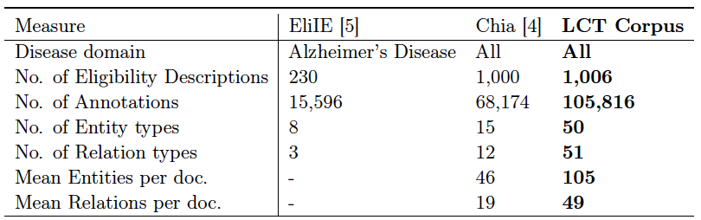
Introduction
Related Work
Task Innovation
Specific Aims
Conclusion
Aim
1
2
3
Aim 1 – Comparison to Chia corpus – Size

Slide 45
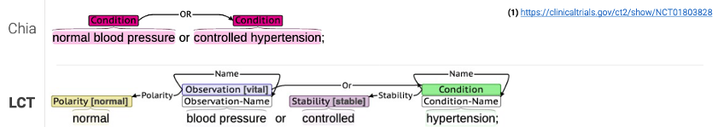
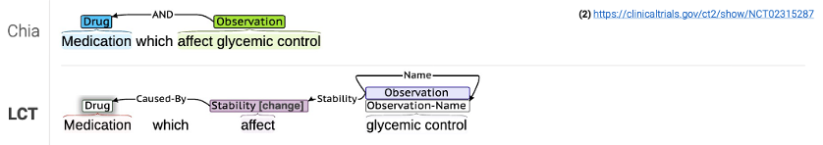
Introduction
Related Work
Task Innovation
Specific Aims
Conclusion
Aim
1
2
3
Aim 1 – Comparison to Chia corpus – Examples 1-2

Slide 46
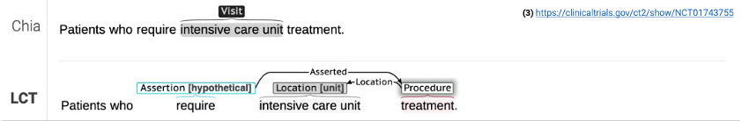
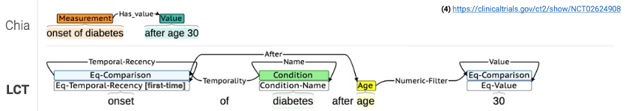
Introduction
Related Work
Task Innovation
Specific Aims
Conclusion
Aim
1
2
3
Aim 1 – Comparison to Chia corpus – Examples 3-4

Slide 47
Introduction
Related Work
Task Innovation
Specific Aims
Conclusion
Aim
1
2
3
Aim 1 – Annotation Process
2 annotators: 1 biomedical informatician, 1 computer science professor.
Met bi-weekly for 3 months.
90% of corpus annotated by annotator 1, remaining 10% double annotated.
After 50% of corpus annotated, remaining 50% of corpus pre-annotated using biLSTM-CRF-based model to speed annotation. Pre-annotations then edited and revised by annotators.
Resulting corpus 887 single-annotated, 119 double-annotated documents.
Inter-annotator agreement by F₁
78.1% for entities, 60.9% for relations by exact character and type matching
Sources:
-F. Dernoncourt, J. Y. Lee, and P. Szolovits. NeuroNER: an easy-to-use program for named-entity recognition based on neural networks. arXiv preprint arXiv:1705.05487, 2017.

Slide 48
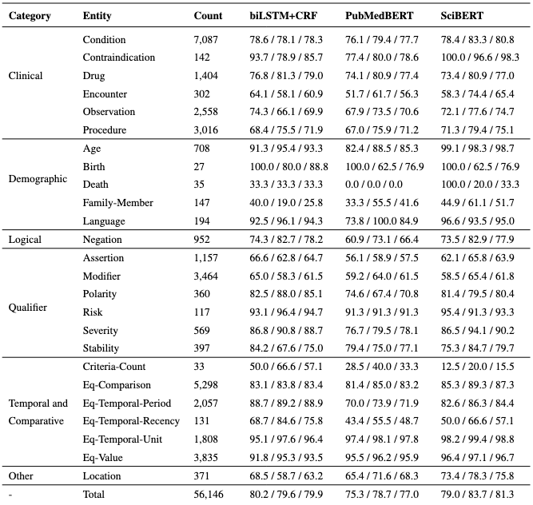
Introduction
Related Work
Task Innovation
Specific Aims
Conclusion
Aim
1
2
3
Aim 1 – Results - Entities
Trained 2 NER models, 1 each for general and fine-grained entities using various architectures
biLSTM+CRF
PubMedBERT (pretrained using PubMed abstracts)
SciBERT (pretrained using biomedical and computer science abstracts)
SciBERT achieved highest overall F₁ of 81.3%
F1 = 2 x (precision x recall) / (precision + recall)
Results displayed by Precision / Recall / F₁

Slide 49
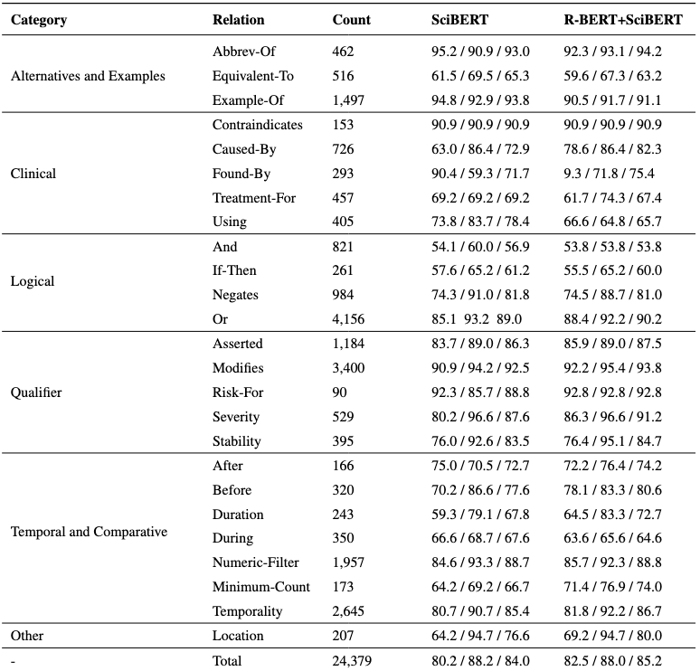
Introduction
Related Work
Task Innovation
Specific Aims
Conclusion
Aim
1
2
3
Aim 1 – Results - Relations
Trained relation extraction models using
SciBERT (pretrained using biomedical and computer science abstracts)
R-BERT + SciBERT (modification of BERT architecture by We & He w/ pretrained SciBERT)
R-BERT + SciBERT achieved highest overall F₁ of 85.2%
Sources:
-Wu, S. & He, Y. Enriching pre-trained language model with entity information for relation classification. In Proceedings of the 28th ACM International Conference on Information and Knowledge Management, 2361–2364 (2019).
Results displayed by Precision / Recall / F₁

Slide 50
Introduction
Related Work
Task Innovation
Specific Aims
Conclusion
Aim
1
2
3
Aim 1 – Quality Evaluation
Corpus largely single-annotated, so also trained NER models on the 887 single-annotated documents and tested on the 199 double-annotated documents.
Also compared by training manually annotated 50% versus semi-automatically annotated 50%.
Results of both experiments very similar, suggest reasonable uniformity across corpus
Training Set | Test Set | P R F₁
Single-annotated | Double-annotated | 79.7 / 82.5 / 81.4
Manual | Semi-automated | 75.4 / 82.1 / 78.6
Semi-automated | Manual | 80.1 / 79.9 / 80.0

Slide 51
Introduction
Related Work
Task Innovation
Specific Aims
Conclusion
Aim
1
2
3
Specific Aims
Create gold standard corpus of eligibility criteria.
Develop methods for generating SQL queries for cohort discovery from free-text.
Develop a web application for finding patients meeting user-provided free-text eligibility criteria.

Slide 52
Introduction
Related Work
Task Innovation
Specific Aims
Conclusion
Aim
1
2
3
Aim 2
Sub-Aim 1
Create corpus of gold standard eligibility criteria logical forms
Sub-Aim 2
Develop methods for query generation using models from Aim1 and Aim2 Sub-Aim1

Slide 53
Introduction
Related Work
Task Innovation
Specific Aims
Conclusion
Aim
1
2
3
Sub-Aim 1
Query generation originally planned as using rules, named entity and relation models from Aim 1.
Collections of named entities with relations as a graph of edges and nodes.
However, we learned that generating queries from graphs is ... difficult and error-prone!

Slide 54
Introduction
Related Work
Task Innovation
Specific Aims
Conclusion
Aim
1
2
3
Queries from graphs – How hard can it be?
Example:
“Currently hospitalized females aged 18-41 with a serum creatinine over 1.0 not at risk for kidney failure”

Slide 55
Introduction
Related Work
Task Innovation
Specific Aims
Conclusion
Aim
1
2
3
Queries from graphs using rules – How hard can it be?
“aged”
Numeric-Filter
“females”
Age
Female
“18-41”
Eq-Comparison
“hospitalized”
Encounter
During
“serum creatinine”
Temporality
Observation
Numeric-Filter
“Currently”
Eq-Temporal-Period
“over 1.0”
Eq-Comparison
“kidney failure”
Risk-For
Negation
“not”
Condition
Negation
“risk”
Risk

Slide 56
Introduction
Related Work
Task Innovation
Specific Aims
Conclusion
Aim
1
2
3
Queries from graphs using rules – How hard can it be?
“aged”
Numeric-Filter
“females”
Age
Female
“18-41”
Eq-Comparison
“hospitalized”
Encounter
During
“serum creatinine”
Temporality
Observation
We could enumerate each clinical or demographic entity (Condition, Procedure, Age, etc.) and generate individual SQL statements, then stitch them together.
Numeric-Filter
“Currently”
Eq-Temporal-Period
“over 1.0”
Eq-Comparison
“kidney failure”
Risk-For
Negation
“not”
Condition
Negation
“risk”
Risk

Slide 57
Introduction
Related Work
Task Innovation
Specific Aims
Conclusion
Aim
1
2
3
Queries from graphs using rules – How hard can it be?
“aged”
Numeric-Filter
“females”
Age
Female
“18-41”
Eq-Comparison
SELECT ... FROM ...
WHERE status=‘admitted’
During
“serum creatinine”
Observation
Numeric-Filter
“over 1.0”
Eq-Comparison
“kidney failure”
Risk-For
Negation
“not”
Condition
Negation
“risk”
Risk

Slide 58
Introduction
Related Work
Task Innovation
Specific Aims
Conclusion
Aim
1
2
3
Queries from graphs using rules – How hard can it be?
“aged”
Numeric-Filter
SELECT ... FROM ...
WHERE sex=‘female’
Age
“18-41”
Eq-Comparison
SELECT ... FROM ...
WHERE status=‘admitted’
During
“serum creatinine”
Observation
Numeric-Filter
“over 1.0”
Eq-Comparison
“kidney failure”
Risk-For
Negation
“not”
Condition
Negation
“risk”
Risk

Slide 59
Introduction
Related Work
Task Innovation
Specific Aims
Conclusion
Aim
1
2
3
Queries from graphs using rules – How hard can it be?
SELECT ... FROM ...
WHERE age >= 18 and age <= 41
SELECT ... FROM ...
WHERE sex=‘female’
SELECT ... FROM ...
WHERE status=‘admitted’
During
“serum creatinine”
Observation
Numeric-Filter
“over 1.0”
Eq-Comparison
“kidney failure”
Risk-For
Negation
“not”
Condition
Negation
“risk”
Risk

Slide 60
Introduction
Related Work
Task Innovation
Specific Aims
Conclusion
Aim
1
2
3
Queries from graphs using rules – How hard can it be?
We already generated SQL for “hospitalized”, but now need to join to a lab. Our first SQL statement needs to be revised. We add a new rule to group certain entities.
SELECT ... FROM ...
WHERE age >= 18 and age <= 41
SELECT ... FROM ...
WHERE sex=‘female’
?
SELECT ... FROM ...
WHERE status=‘admitted’
During
“serum creatinine”
Observation
Numeric-Filter
“over 1.0”
Eq-Comparison
“kidney failure”
Risk-For
Negation
“not”
Condition
Negation
“risk”
Risk

Slide 61
Introduction
Related Work
Task Innovation
Specific Aims
Conclusion
Aim
1
2
3
Queries from graphs using rules – How hard can it be?
SELECT ... FROM ...
WHERE age >= 18 and age <= 41
SELECT ... FROM ...
WHERE sex=‘female’
SELECT ...
FROM encounters
INNER JOIN labs ON ...
WHERE encounters.status=‘admitted’
AND labs.type = ‘creatinine’
AND labs.value > 1.0
“kidney failure”
Risk-For
Negation
“not”
Condition
Negation
“risk”
Risk

Slide 62
Introduction
Related Work
Task Innovation
Specific Aims
Conclusion
Aim
1
2
3
Queries from graphs using rules – How hard can it be?
SELECT ... FROM ...
WHERE age >= 18 and age <= 41
SELECT ... FROM ...
WHERE sex=‘female’
SELECT ...
FROM encounters
INNER JOIN labs ON ...
WHERE encounters.status=‘admitted’
AND labs.type = ‘creatinine’
AND labs.value > 1.0
We already generated SQL for “kidney failure”, but now we find it is actually only a risk, and we shouldn’t check for that. Add another rule.
We next find that the risk is actually negated! We need to revise our SQL yet again.
?
SELECT ... FROM ...
WHERE condition=‘kidney failure’
?
Risk-For
Negation
“not”
Negation
“risk”
Risk

Slide 63
Introduction
Related Work
Task Innovation
Specific Aims
Conclusion
Aim
1
2
3
Queries from graphs using rules – How hard can it be?
High likelihood of ending up with many if-then, if-then, if then statements.
Difficult to maintain, test, and manage.
“And” and “Or” relations complicate this further.

Slide 64
Introduction
Related Work
Task Innovation
Specific Aims
Conclusion
Aim
1
2
3
A Better Approach? Semantic Parsing
“Currently hospitalized females aged 18-41 with a serum creatinine over 1.0 not at risk for kidney failure”
intersect(
seq(
enc(INPATIENT)
.temporality(eq(eq_temporal_per(CURRENT))),
during(
lab(“serum_creatinine”)
.num_filter(eq(op(GT), val(“1.0”))
)
),
female(),
age()
.num_filter(
eq(op(BETWEEN), val(”18”), val(“41”)),
neg(
risk(
cond(“kidney failure”)
)
)
)
Representing as a semantic parse disambiguates both relations and ”nesting”.
Many rules become unnecessary or can be restructured as class/object-specific logic.

Slide 65
Introduction
Related Work
Task Innovation
Specific Aims
Conclusion
Aim
1
2
3
Sub-Aim 1– Corpus Creation
Randomly selected 2,000 lines of eligibility criteria from the LCT corpus.
30% of lines (600) rare or complex entity/relation types. (If-Then, Before/After, Contraindication, etc.)
Remaining 70% random.
Limited to lines with at least 1 annotated entity and not hypothetical.
20 lines for annotator training, remainder for main annotation task.
Called “Leaf Logical Form” or “LLF” corpus

Slide 66
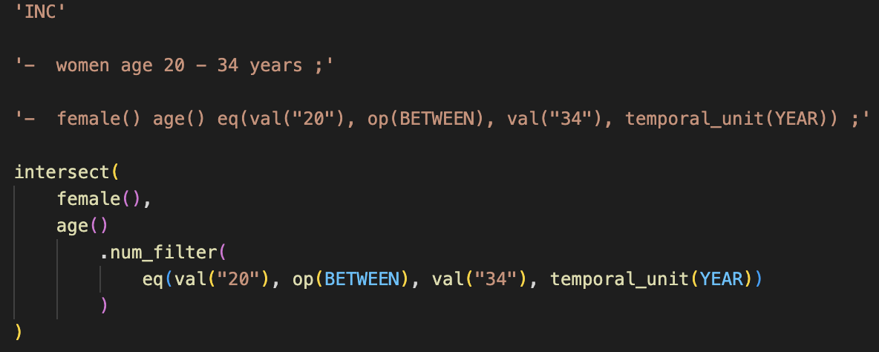
Introduction
Related Work
Task Innovation
Specific Aims
Conclusion
Aim
1
2
3
Sub-Aim 1– Corpus Creation (cont.)
Each eligibility criteria line saved as a JavaScript file of format:
Replaced “raw” spans with logical form names to (1) improve prediction performance, (2) make annotation task easier for annotators. We called the replaced text “augmented”.
Used JavaScript files to leverage syntax highlighting, indentation to ease annotation.
Inclusion or Exclusion
Original text
Augmented text
Logical Form human annotation

Slide 67
Introduction
Related Work
Task Innovation
Specific Aims
Conclusion
Aim
1
2
3
Sub-Aim 1 – Annotation Process
3 annotators: all UW PhD students, 2 in BIME, 1 in Information School.
Met weekly for 2 months.
20 files double-annotated by all for training.
Resulting corpus 1,980 single-annotated, 20 double-annotated files.
Inter-annotator agreement by BLEU: 82.4%.
Annotators | BLEU Score (%)
Annotator 1 / Annotator 2 | 86.6
Annotator 1 / Annotator 3 | 79.5
Annotator 2 / Annotator 3 | 81.0
Mean | 82.4

Slide 68
Introduction
Related Work
Task Innovation
Specific Aims
Conclusion
Aim
1
2
3
Sub-Aim 1 – Results
Experimented with other logical form syntax styles based on literature, mainly in research for digital assistants.
Shift-Reduce – square brackets before predicates, blank spaces instead of commas, trailing repeat of predicate names
Pointer – replace quoted text – e.g., ”diabetic” – with “@_{i}” where i refers to i^{th} instance of quoted text a line of criterion
Experiments conducted using ”T5” a Transformer-based architecture and pretrained model for various Seq2Seq tasks.
Sources:
-A. Einolghozati, P. Pasupat, S. Gupta, R. Shah, M. Mohit, M. Lewis, and L. Zettlemoyer. Improving semantic parsing for task oriented dialog. arXiv preprint arXiv:1902.06000, 2019.
-S. Rongali, L. Soldaini, E. Monti, and W. Hamza. Don’t parse, generate! a sequence to sequence architecture for task-oriented semantic parsing. In Proceedings of The Web Conference 2020, pages 2962–2968, 2020.
-C. Raffel, N. Shazeer, A. Roberts, K. Lee, S. Narang, M. Matena, Y. Zhou, W. Li, P. J. Liu, et al. Exploring the limits of transfer learning with a unified text-to-text transformer. J. Mach. Learn. Res., 21(140):1–67, 2020.

Slide 69
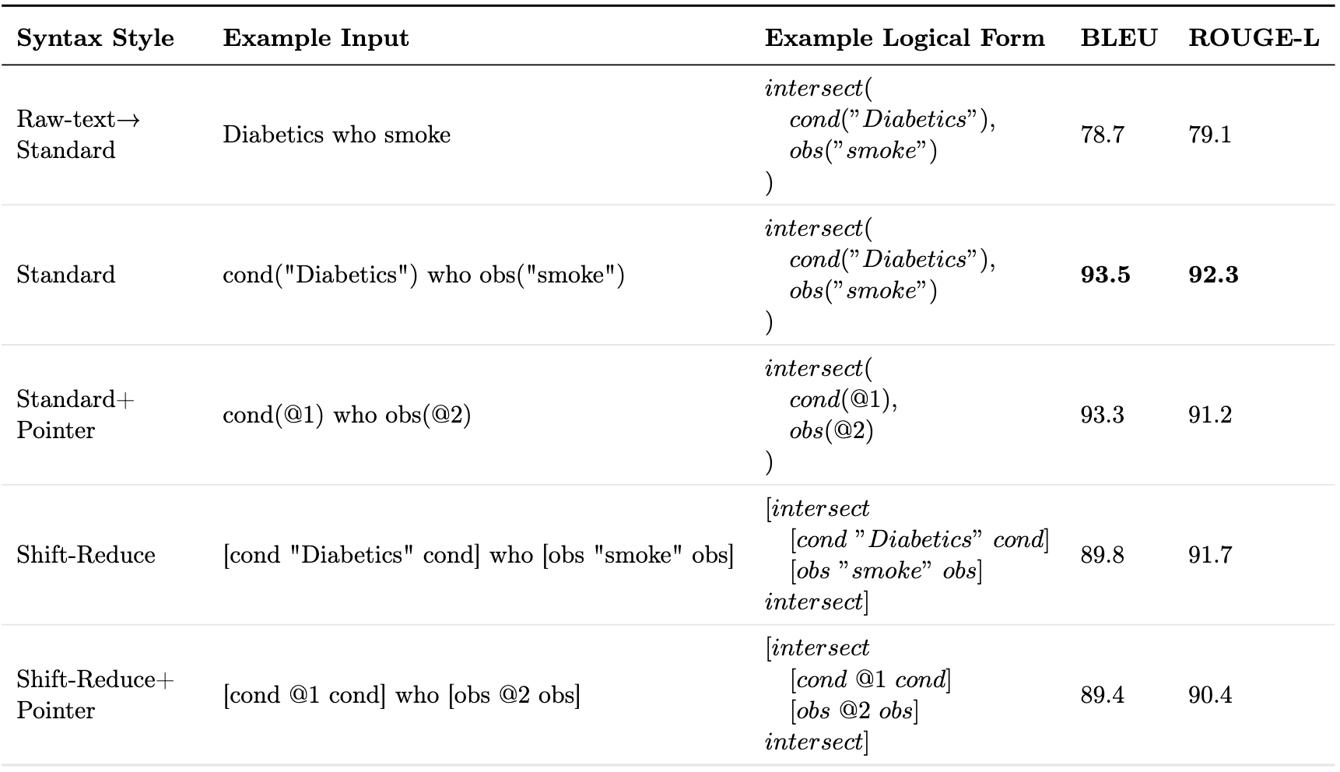
Introduction
Related Work
Task Innovation
Specific Aims
Conclusion
Aim
1
2
3
Sub-Aim 1 – Results
Random 70/20/10 train/test/dev split of corpus.
Original annotation syntax style, “Standard”, scored highest.
Replacing raw spans with named entity logical forms improved by +14.7%.

Slide 70
Introduction
Related Work
Task Innovation
Specific Aims
Conclusion
Aim
1
2
3
Aim 2
Sub-Aim 1
Create corpus of gold standard eligibility criteria logical forms
Sub-Aim 2
Develop methods for query generation using models from Aim1 and Aim2 Sub-Aim1

Slide 71
Introduction
Related Work
Task Innovation
Specific Aims
Conclusion
Aim
1
2
3
Sub-Aim 2 - Goals
Generate queries to find patients meeting free-text eligibility criteria.
System should
Be database schema-agnostic.
Be capable of reasoning on non-specific criteria.
Utilize models trained on LCT and LLF corpora .
Achieve near-human level performance in finding patients.

Slide 72
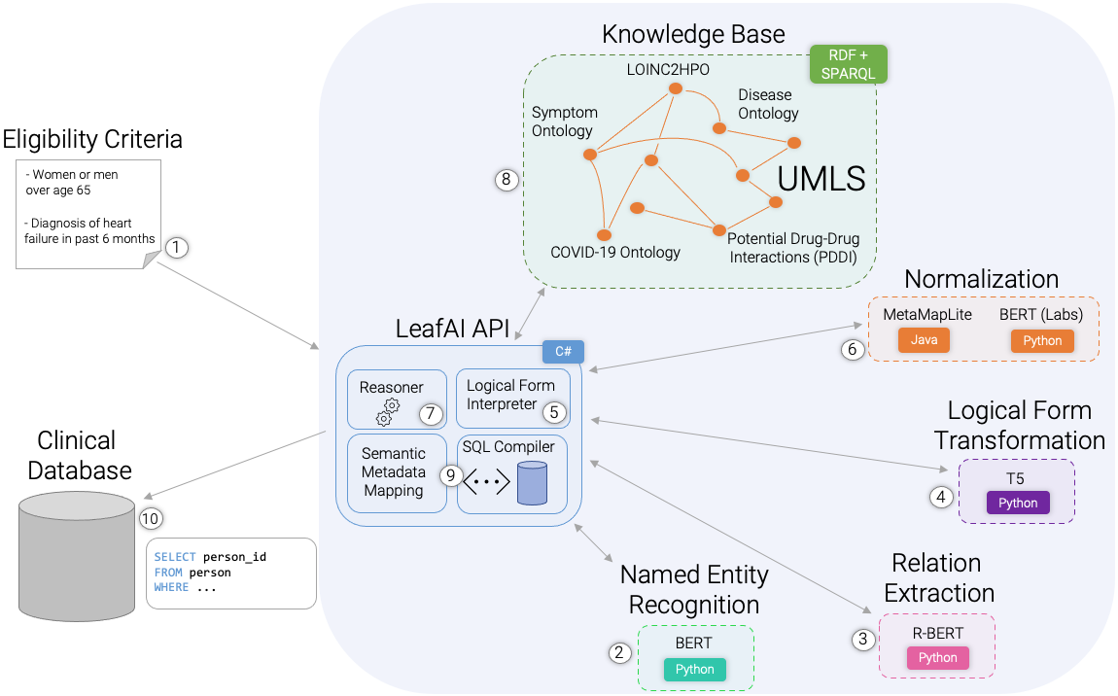
Introduction
Related Work
Task Innovation
Specific Aims
Conclusion
Aim
1
2
3
Sub-Aim 2 – System Overview

Slide 73
Introduction
Related Work
Task Innovation
Specific Aims
Conclusion
Aim
1
2
3
Sub-Aim 2 – Knowledge Base
Built using RDF, or Resource Description Framework graph database of triples.
Core is the UMLS. Also includes
LOINC2HPO (for Lab Result -> Condition reasoning)
Disease Ontology
Symptom Ontology
Potential Drug-Drug Interactions
COVID-19 Ontology
Query-able using SPARQL query language
Knowledge Base
LOINC2HPO
RDF + SPARQL
Disease Ontology
Symptom Ontology
UMLS
COVID-19 Ontology
Potential Drug-Drug Interactions (PDDI)
Sources:
-L. M. Schriml, C. Arze, S. Nadendla, Y.-W. W. Chang, M. Mazaitis, V. Felix, G. Feng, and W. A. Kibbe. Disease Ontology: a backbone for disease semantic integration. Nucleic acids research, 40(D1):D940–D946, 2012.
-A. Sargsyan, A. T. Kodamullil, S. Baksi, J. Darms, S. Madan, S. Gebel, O. Keminer, G. M. Jose, H. Balabin, L. N. DeLong, et al. The COVID-19 ontology. Bioinformatics, 36(24):5703–5705, 2020.
-S. Ayvaz, J. Horn, O. Hassanzadeh, Q. Zhu, J. Stan, N. P. Tatonetti, S. Vilar, M. Brochhausen, M. Samwald, M. Rastegar-Mojarad, et al. Toward a complete dataset of drug–drug interaction information from publicly available sources. Journal of biomedical informatics, 55:206–217, 2015.
-X. A. Zhang, A. Yates, N. Vasilevsky, J. Gourdine, T. J. Callahan, L. C. Carmody, D. Danis, M. P. Joachimiak, V. Ravanmehr, E. R. Pfaff, et al. Semantic integration of clinical laboratory tests from electronic health records for deep phenotyping and biomarker discovery. NPJ digital medicine, 2(1):1–9, 2019.

Slide 74
Introduction
Related Work
Task Innovation
Specific Aims
Conclusion
Aim
1
2
3
Sub-Aim 2 – Normalization
Non-lab related concepts (e.g., conditions, procedures) normalized using wrapper around MetaMapLite.
Semantic types likely erroneous or unhelpful for query generation ignored.
For example, condition concepts limited to only concepts of semantic types “Diseases and Syndromes”, “Signs and Symptoms”, etc.
Labs normalized using a BERT for sequence classification model trained on ~200 commonly used labs at UW
Normalization
MetaMapLite
BERT (Labs)
Java
Python
drug(“metformin”)
CUI: C0025598
Sources:
-Demner-Fushman, Dina, Willie J. Rogers, and Alan R. Aronson. "MetaMap Lite: an evaluation of a new Java implementation of MetaMap." Journal of the American Medical Informatics Association 24.4 (2017): 841-844.
-J. Devlin, M.-W. Chang, K. Lee, and K. Toutanova. Bert: Pre-training of deep bidirectional trans- formers for language understanding. arXiv preprint arXiv:1810.04805, 2018.

Slide 75
Introduction
Related Work
Task Innovation
Specific Aims
Conclusion
Aim
1
2
3
Sub-Aim 2 – Semantic Metadata Mapping
Logical forms are a database schema-agnostic representation of eligibility criteria logic.
Map logical forms to a ”Semantic Metadata Mapping”, or “SMM”.
Machine-readable “tagging” system for mapping database tables, columns, and records to their ”meaning”, using UMLS concepts.
C0421451 “Female”
If = “gender = ‘F’”
C0086582 “Male”
If = “gender = ‘M’”
C5236161 “Patient Identifier”
C0421451
“Date of Birth”
person_id | birthdate | gender
1 | 1-1-2000 | F
2 | 2-2-1980 | M
3 | 3-3-1970 | F

Slide 76
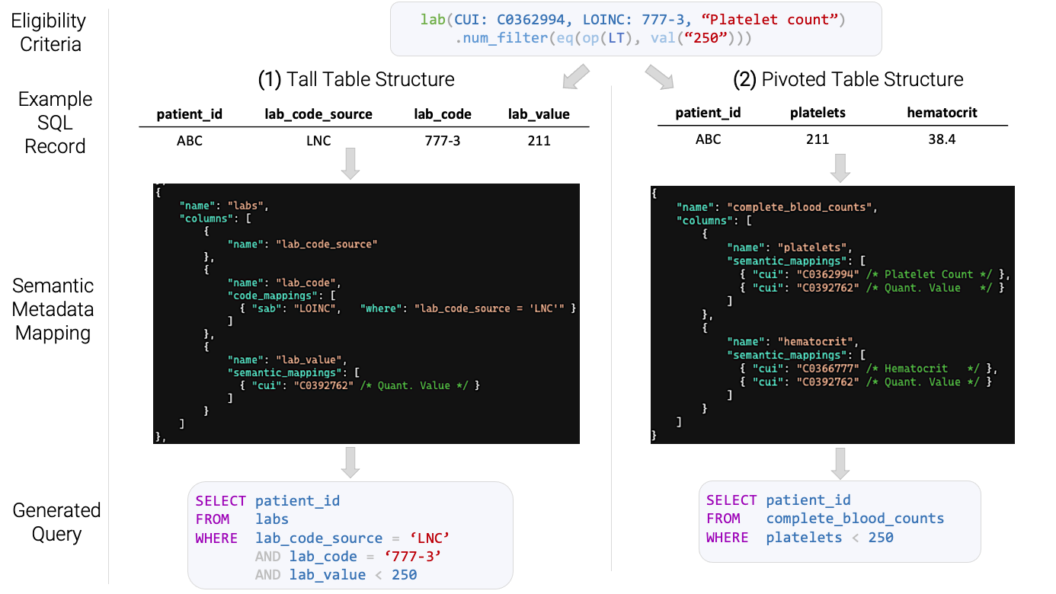
Introduction
Related Work
Task Innovation
Specific Aims
Conclusion
Aim
1
2
3

Slide 77
Introduction
Related Work
Task Innovation
Specific Aims
Conclusion
Aim
1
2
3

Slide 78
Introduction
Related Work
Task Innovation
Specific Aims
Conclusion
Aim
1
2
3

Slide 79
Introduction
Related Work
Task Innovation
Specific Aims
Conclusion
Aim
1
2
3

Slide 80
Introduction
Related Work
Task Innovation
Specific Aims
Conclusion
Aim
1
2
3

Slide 81
Introduction
Related Work
Task Innovation
Specific Aims
Conclusion
Aim
1
2
3
Aim 2 – Process – Steps 1,2
Named Entity Recognition (NER) using BERT and Relation Extraction using R-BERT.
Or
Numeric-Filter
“- Diabetic women and men aged over 65 with no contraindications to metformin”
Condition
Female
Male
Age
Eq-Comparison
-
Diabetic
women
and
men
aged
over 65
Operator: Greater Value: “65”
Negates
Contraindicates
Negation
Contraindication
Drug
with
no
contraindications
to
metformin
Named Entity Recognition
Relation Extraction
BERT
R-BERT
Python
Python

Slide 82
Introduction
Related Work
Task Innovation
Specific Aims
Conclusion
Aim
1
2
3
Aim 2 – Process – Steps 2,3
Transform to logical form prediction input string, replacing raw text named entities values with named entities names and removing any hypothetical events.
Or
Numeric-Filter
“- Diabetic women and men aged over 65 with no contraindications to metformin”
“- cond(“Diabetic”) female() and male()
age() eq(op(GT), val(“65”))
with neg() contraindication() to
drug(“metformin”)”
Condition
Female
Male
Age
Eq-Comparison
-
Diabetic
women
and
men
aged
over 65
Operator: Greater Value: “65”
Negates
Contraindicates
Negation
Contraindication
Drug
with
no
contraindications
to
metformin

Slide 83
Introduction
Related Work
Task Innovation
Specific Aims
Conclusion
Aim
1
2
3
Aim 2 – Process – Steps 4,5
Predict structured logical form using fine-tuned T5 model, output as a string. Then, parse logical forms and instantiate as in-memory nested object structure.
intersect(
,
union(
,
),
.num_filter(
),
(
(
)
)
)
“-
cond(“Diabetic”)
“-
cond(“Diabetic”)
female()
and
female()
and
age()
male()
age()
eq(op(GT), val(“65”))
male()
eq(op(GT), val(“65”))
()
neg
()
with
neg
()
contraindication
with
()
contraindication
to
to
”
drug(“metformin”)
”
drug(“metformin”)
Logical Form Transformation
T5
Python

Slide 84
Introduction
Related Work
Task Innovation
Specific Aims
Conclusion
Aim
1
2
3
Aim 2 – Process – Step 6
Normalize to UMLS concepts using MetaMapLite and BERT (the latter only in the case of lab tests).
intersect(
cond(“Diabetic”),
union(
female(),
male()
),
age()
.num_filter(
eq(op(GT), val(“65”))
),
neg(
contraindication(
drug(“metformin”)
)
)
)
intersect(
cond(C0241863 “Diabetic”),
union(
female(),
male()
),
age()
.num_filter(
eq(op(GT), val(“65”))
),
neg(
contraindication(
drug(C0025598 “metformin”)
)
)
)
Normalization
MetaMapLite
BERT (Labs)
Java
Python

Slide 85
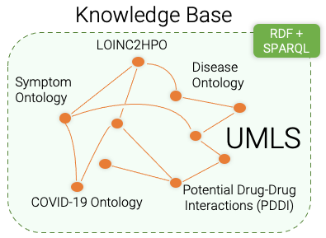
Introduction
Related Work
Task Innovation
Specific Aims
Conclusion
Aim
1
2
3
Aim 2 – Process – Steps 7,8
Reason using Knowledge Base to determine: contraindications, indications, risk factors, signs / symptoms, unspecified criteria.
intersect(
cond(C0241863 “Diabetic”),
union(
female(),
male()
),
age()
.num_filter(
eq(op(GT), val(“65”))
),
neg(
contraindication(
drug(C0025598 “metformin”)
)
)
)
intersect(
cond(CUI: C0241863 “Diabetic”),
union(
female(),
male()
),
age()
.num_filter(
eq(op(GT), val(“65”))
),
neg(
cond(C0220981 “Metabolic acidosis”),
drug(C3253985 “Dolutegravir”)
)
)

Slide 86
Introduction
Related Work
Task Innovation
Specific Aims
Conclusion
Aim
1
2
3
Aim 2 – Process – Step 10
Link to the Semantic Metadata Mapping to generate SQL statements.
{
name: ”person”
columns:
{
name: “sex”
semantic_mappings:
C0086287 if sex = “F”
C0086582 if sex = “M”
}
{
name: “age”,
semantic_mappings: C0001779
}
{
name: “conditions”
columns:
{
name: “condition_code”
code_mappings:
ICD10 if code_source = “I10”
}
{
name: “code_source”
}
}
intersect(
C0241863, SABs: ICD10...
union(
C0086287,
C0086582,
),
C0001779
.num_filter(
eq(op(GT), val(“65”))
),
neg(
C0220981, SABs: ICD10...,
C3253985, SABs: RxNorm...
)
)
intersect(
cond(“Diabetic”),
union(
female(),
male()
),
age()
.num_filter(
eq(op(GT), val(“65”))
),
neg(
contraindication(
drug(“metformin”)
)
)
)
Semantic Metadata Mapping, SQL Generation

Slide 87
Introduction
Related Work
Task Innovation
Specific Aims
Conclusion
Aim
1
2
3
Aim 2 – Process – Step 10
Use mapped database schema paired with logical forms to generate SQL statements using rules.
intersect(
C0241863 “condition_code”
union(
C0086287 “sex = ‘F’”,
C0086582 “sex = ‘M’”,
),
C0001779 “age”
.num_filter(
eq(op(GT), val(“65”))
),
neg(
C0220981 “condition_code”,
C3253985 “drug_code”
)
)
SELECT person_id FROM condition ...
INTERSECT
SELECT person_id FROM (
SELECT person_id FROM person
WHERE sex = ‘F’
UNION
SELECT person_id FROM person
WHERE sex = ‘M’
)
INTERSECT
SELECT person_id FROM person
WHERE age > 65
INTERSECT
SELECT person_id FROM person
WHERE NOT EXISTS...
SQL Generation

Slide 88
Introduction
Related Work
Task Innovation
Specific Aims
Conclusion
Aim
1
2
3
Aim 2 – Multi-hop Reasoning
”Contraindications to drugs for conditions which affect respiration”
contraindication(
drug()
.for(
obs(“respiration”)
.change()
.caused_by(
cond()
)
)
)

Slide 89
Introduction
Related Work
Task Innovation
Specific Aims
Conclusion
Aim
1
2
3
Aim 2 – Multi-hop Reasoning
”Contraindications to drugs for conditions which affect respiration”
contraindication(
drug()
.for(
obs(“respiration”)
.change()
.caused_by(
cond()
)
)
)
1
Asthma causes changes to respiration

Slide 90
Introduction
Related Work
Task Innovation
Specific Aims
Conclusion
Aim
1
2
3
Aim 2 – Multi-hop Reasoning
”Contraindications to drugs for conditions which affect respiration”
contraindication(
drug()
.for(
obs(“respiration”)
.change()
.caused_by(
cond()
)
)
)
2
Methylprednisolone can be used to treat asthma
1
Asthma causes changes to respiration

Slide 91
Introduction
Related Work
Task Innovation
Specific Aims
Conclusion
Aim
1
2
3
Aim 2 – Multi-hop Reasoning
”Contraindications to drugs for conditions which affect respiration”
contraindication(
drug()
.for(
obs(“respiration”)
.change()
.caused_by(
cond()
)
)
)
Mycosis (fungal infection) is a contraindication to methylprednisolone
3
2
Methylprednisolone can be used to treat asthma
1
Asthma causes changes to respiration

Slide 92
Introduction
Related Work
Task Innovation
Specific Aims
Conclusion
Aim
1
2
3
Aim 2 – Evaluation
Extracted metadata on 165 clinical trials at UW between Jan. 2010 and Dec. 2021
At least 10 patients enrolled
Number of lines of eligibility criteria file <= 30
Grouped trials by “condition” field
Randomly chose 1 trial per condition (except cancer, where 2 chosen), 8 total
Generated SQL queries using LeafAI and human programmer, replacing current date references (GETDATE() function) with trial start and end date bounds, to simulate enrollment during trial
Human instructed to
Skip criterion which cannot be known / computed or not in database
Reason about non-specific criteria where possible (e.g., symptoms, contraindications)

Slide 93
Introduction
Related Work
Task Innovation
Specific Aims
Conclusion
Aim
1
2
3
Aim 2 – Example Trial
Query executed (by LeafAI)
Skipped / no data / error
Inclusion Criteria:
Patients with newly diagnosed advanced stage (III/IV) ovarian cancer (ovarian/fallopian tube/peritoneal cancer) who have been recommended to receive ...
Patients must have Eastern Cooperative Oncology Group (ECOG) performance status score of =< 2
Patients must have recovered from major infections and/or surgical procedures, and in the opinion of the investigator, not have any significant active ...
Estimated life expectancy of more than 6 months
White blood cells (WBC) >= 3000/mm^3 within 30 days of enrollment to study
Hemoglobin (Hgb) >= 10 g/dl within 30 days of enrollment to study
Hematocrit (Hct) >= 28% within 30 days of enrollment to study
Serum creatinine =< 2.0 mg/dl or creatinine clearance > 60 ml/min within 30 days of enrollment to study
Total bilirubin =< 2.5 mg/dl within 30 days of enrollment to study
Aspartate aminotransferase (AST)/serum glutamic oxaloacetic transaminase (SGOT) =< 3 times upper limit of normal (ULN) within 30 days of enrollment to study
Blood glucose <1.5 ULN within 30 days of enrollment to study
All patients who are having sex that can lead to pregnancy must agree to contraception for the duration of the study
Patients must be at least 18 years of age
Exclusion Criteria:
Patients with any of the following cardiac conditions: Symptomatic restrictive cardiomyopathy, Unstable angina within 4 months prior to enrollment, New York Heart Association functional class III-IV heart failure on active treatment, Symptomatic pericardial effusion
Uncontrolled diabetes
History of (non-infectious) pneumonitis that required steroids or current pneumonitis
Patients with any contraindication to receiving rhuGM-CSF based products
Patients with any clinically significant autoimmune disease uncontrolled with treatment
Patients who are currently receiving an anti-IGF-IR monoclonal antibody as part of their treatment regimen
Patients who are simultaneously enrolled in any other treatment study
Patients who are pregnant or breastfeeding

Slide 94
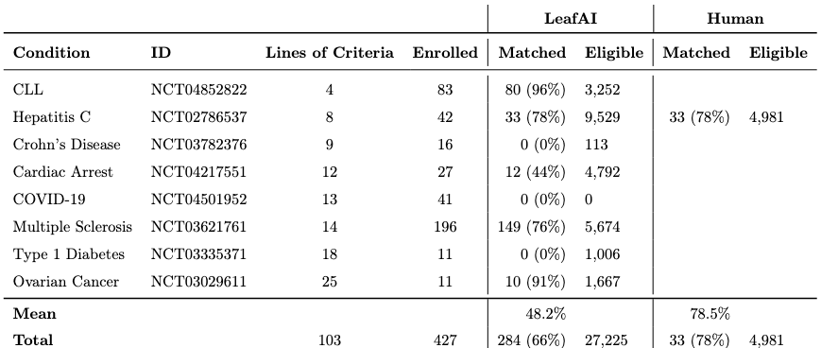
Introduction
Related Work
Task Innovation
Specific Aims
Conclusion
Aim
1
2
3
Aim 2 – Results
LeafAI found over 40% of matching patients in 5/8 trials.
Zero patients matched in 3/8 trials.
Human-generated query writing ongoing.

Slide 95
Introduction
Related Work
Task Innovation
Specific Aims
Conclusion
Aim
1
2
3
Aim 2 – Summary
Created eligibility criteria text to logical form (LLF) corpus
Validation BLEU score 93.5%, inter-annotator agreement 82.4%
Created methods for query generation
Database schema agnostic
Capable of reasoning on non-specific criteria
Evaluated using 8 UW clinical trials, found matching patients in 5/8 trials, 66% recall

Slide 96
Introduction
Related Work
Task Innovation
Specific Aims
Conclusion
Aim
1
2
3
Specific Aims
Create gold standard corpus of eligibility criteria.
Develop methods for generating SQL queries for cohort discovery from free-text.
Develop a web application for finding patients meeting user-provided free-text eligibility criteria.

Slide 97
Introduction
Related Work
Task Innovation
Specific Aims
Conclusion
Aim
1
2
3
Aim 3 – Goals
Create an interactive self-service web application which generates and runs cohort discovery SQL queries on user-entered free-text criteria
User interface
Accessible user action history with chat-like interface
Previous actions and responses preserved above, new inputs inserted below
Rapid feedback, responsiveness from system
Explainability of system actions
Editable system responses enabling iteration, exploration

Slide 98

Introduction
Related Work
Task Innovation
Specific Aims
Conclusion
Aim
1
2
3
User-entered free-text eligibility criteria
Had a BMI between 35 and 40 within the past 6 months
Were treated with an SSRI or other antidepressant
Are aged 18 – 65 and don’t regularly exercise
Were seen in the emergency department in the past three years
Leaf AI’s response
I couldn’t identify patients who “don’t regularly exercise”, so you may need to refine your search, however:
53 patients were found:
1) 1,046 had a body mass index (BMI) between 35 and 40 (in the past 6 months)
2) 442 were treated with a Selective Serotonin Re-uptake Inhibitor (SSRI) or other antidepressant (anytime)
3) 421 are aged between 18 and 65
4) 53 were seen in the Emergency Department (in the past 3 years)

Slide 99
Introduction
Related Work
Task Innovation
Specific Aims
Conclusion
Aim
1
2
3
Aim 3 – Goals – Rapid feedback / Responsiveness
Bi-directional streaming interfaces between client and server
Enables server to update client as to progress incrementally, second-by-second

Slide 100
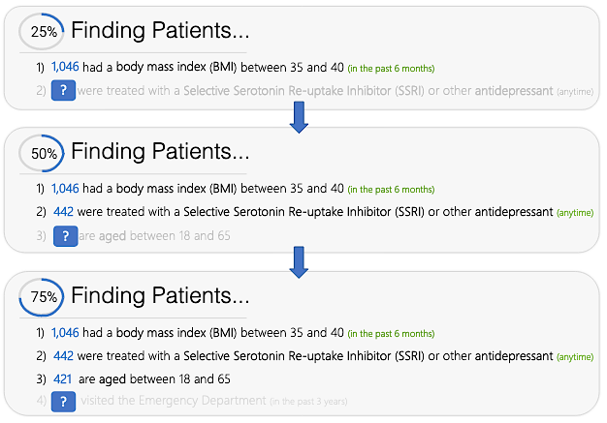
Introduction
Related Work
Task Innovation
Specific Aims
Conclusion
Aim
1
2
3
Aim 3 – Goals – Rapid feedback / Responsiveness
Each line of criteria executed as individual SQL statement
Streaming interfaces allow client to be updated incrementally as each line completed

Slide 101


Introduction
Related Work
Task Innovation
Specific Aims
Conclusion
Aim
1
2
3
Aim 3 – Goals – Explainability
If user writes eligibility criteria but does not know if system will understand until after queries executed:
Wasted time if query fails
Uncertainty, lack of trust in system
System will therefore perform NER and normalization as user types criteria
Allows user to better anticipate problems, understand system interpretation
BMI between 35 and 40 within the past 6 months
Body Mass Index (UMLS: C1305855)
A general indicator of the body fat an individual is carrying based upon the ratio of weight to height.
Previous diagnosis of Diabeets Mellitus
Unknown Condition (?)
LeafAI couldn’t figure out what this is. Check the spelling or try phrasing the name in another way.

Slide 102


Introduction
Related Work
Task Innovation
Specific Aims
Conclusion
Aim
1
2
3
Aim 3 – Goals – Explainability (cont.)
After query results returned, query inputs can be viewed and edited directly, re-run
Reasoned concepts can be enabled / disabled
Query result explanation in English will likely be generated using rules from logical form structure, rather than neural language model, etc.
1) 221 have contraindications to Metformin
Contraindications to Metformin
LeafAI found the following concepts which may be relevant. You can add or remove any of these and rerun your query.
Renal Insufficiency (UMLS: C0035078)
Dolutegravir (UMLS: C3253985)
+ Add Other Concepts

Slide 103
Introduction
Related Work
Task Innovation
Specific Aims
Conclusion
Aim
1
2
3
Aim 3 –Goals – Iterative exploration
User edits criteria based on results
Enabling user to directly edit previous query results
Saves time
Enables faster iteration, exploration
... have diagnosis of diabetes or A1c over 6.5%
... are over 18 30 years old
LeafAI responds with results
5,422 patients found
-6,149 have diagnosis of diabetes
-5,422 are over 18 years old
LeafAI responds with updated results
6,629 patients found
-7,587 have diagnosis of diabetes or A1c over 6.5%
-6,629 are over 30 years old
User provides initial criteria
-Have diagnosis of diabetes -Are over 18 years old

Slide 104
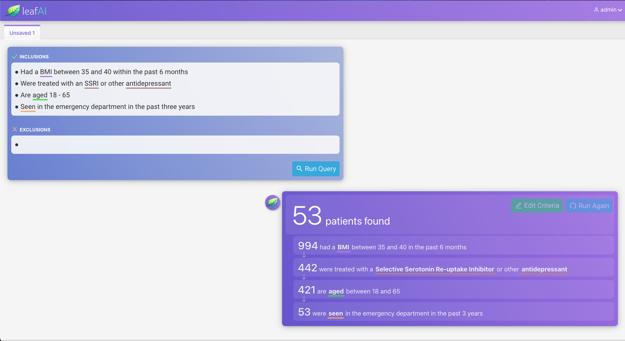

Slide 105
Introduction
Related Work
Task Innovation
Specific Aims
Conclusion
Aim
1
2
3
Aim 3 –Evaluation
2 methods
Usability / user satisfaction
Query accuracy matching patients real clinical trials’ eligibility criteria
Process
Recruit 10 researchers who have not used Leaf (or LeafAI)
Randomly assign each to Leaf group or LeafAI group
Populate clinical database with patients from 5 clinical trials + other randomly selected patients not in trials
Train participants, assign each to find patients based on eligibility criteria from 1 assigned trial
Afterward, participants answer usability and user satisfaction questionnaire

Slide 106
Introduction
Related Work
Task Innovation
Specific Aims
Conclusion
Project Limitations
Both LCT and LLF corpora annotated by non-clinicians.
Clinical trials evaluated in Aims 2/3 only a small sample of all clinical trials (at UW and elsewhere).
Queries generated use subsets of all data available within EHR.
Certain queries and data likely cannot be handled by our system.

Slide 107
Introduction
Related Work
Task Innovation
Specific Aims
Conclusion
Future Work
Logical forms representations and methods can be adapted for general purpose question answering.
Using predicates proposed by Roberts and Demner-Fuschman, such as latest(), λ(), or min() , our logical forms could be “wrapped”
Our logical forms nested and used for data retrieval.
Roberts & Demner-Fuschman predicates used for top-level analysis, answer.
λ( measurement(”temperature”) .num_filter(eq(op(GT), val(”38”), unit(”C”))) .temporality(eq(op(LTEQ), val(”48”), unit(HOUR))) )
“Did the patient’s temperature exceed 38C in the last 48 hours?”
Sources:
-K. Roberts and D. Demner-Fushman. Annotating logical forms for EHR questions. In LREC... International Conference on Language Resources & Evaluation:[proceedings]. International Conference on Language Resources and Evaluation, volume 2016, page 3772. NIH Public Access, 2016.

Slide 108
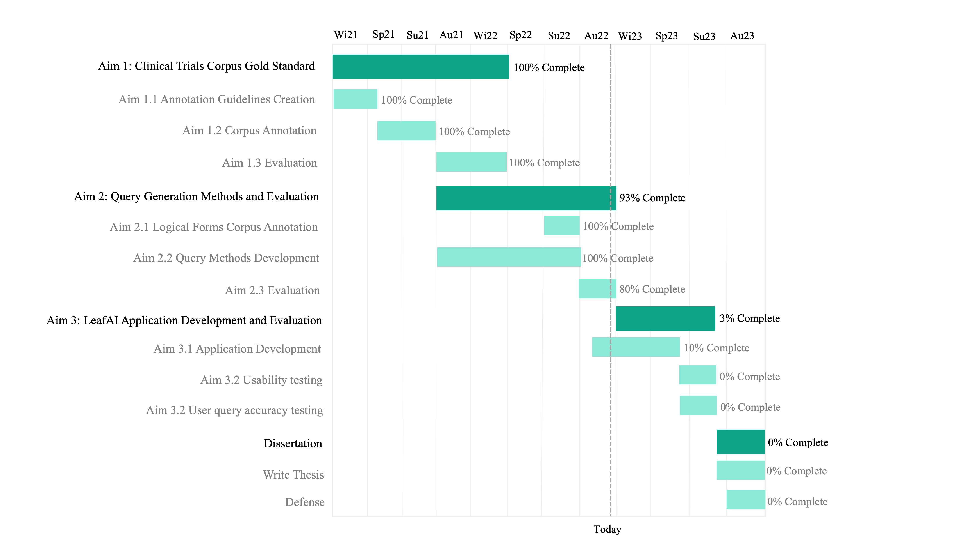
Introduction
Related Work
Task Innovation
Specific Aims
Conclusion
Timeline

Slide 109
Introduction
Related Work
Task Innovation
Specific Aims
Conclusion
Acknowledgements
My Committee Members
Meliha Yetisgen
Nina Kim
Trevor Cohen
Fei Xia
Annotators and Collaborators
Tony Mullen
Bin Han
Weipeng Zhou
Organizations
UWM Research IT
ITHS

Slide 110
Introduction
Related Work
Task Innovation
Specific Aims
Conclusion
Relevant First- or Co-First-Authored Work
Dobbins, N. J., Spital, C. H., Black, R. A., Morrison, J. M., De Veer, B., Zampino, E., ... & Mooney, S. D. (2020). Leaf: an open-source, model-agnostic, data-driven web application for cohort discovery and translational biomedical research. Journal of the American Medical Informatics Association, 27(1), 109-118.
Lee, K., Dobbins, N. J., McInnes, B., Yetisgen, M., & Uzuner, Ö. (2021). Transferability of neural network clinical deidentification systems. Journal of the American Medical Informatics Association, 28(12), 2661-2669.
Dobbins, N. J., Mullen, T., Uzuner, Ö., & Yetisgen, M. (2022). The Leaf Clinical Trials Corpus: a new resource for query generation from clinical trial eligibility criteria. Nature Scientific Data, 9(1), 1-15.
Lybarger, K., Dobbins, N.J., Long, R., Singh. A., Wedgeworth, P., Uzuner, O., Yetisgen, M. Leveraging natural language processing to augment structured social determinants of health data in the electronic health record. (in review)

Slide 111
Introduction
Related Work
Task Innovation
Specific Aims
Conclusion
Questions?

